Slide 1
Hibernate Sesi Ke 2
Association
Notes:
Motion
(Basic)
Note: This video template is optimized for Microsoft PowerPoint 2010.
In PowerPoint 2007, video elements will play, but any content overlapping the video bars will be covered by the video when in slideshow mode.
In PowerPoint 2003, video will not play, but the poster frame of the videos will remain in place as static images.
The video:
Plays automatically after each slide transition.
Is 15 seconds long.
Seamlessly loops for infinite playback.
To add slides or change layout:
To add a new slide, on the Home tab, in the Slides group, click the arrow under New Slide, then click under Motion Background Theme, then select the desired layout.
To change the layout of an existing slide, on the Home tab, in the Slides group, click Layout, then select the desired layout.
Other animated elements:
Any animated element you insert will begin after the slide transition and the background video has started.

Slide 2
Mapping
Entity Relationships

Slide 3
Mappings
Collection mapping
Association mapping
Component mapping

Slide 4
Entity Relationships
There are four types of relationship multiplicities:
@OneToOne
@OneToMany
@ManyToOne
@ManyToMany
The direction of a relationship can be:
bidirectional – owning side and inverse side
unidirectional – owning side only

Slide 5
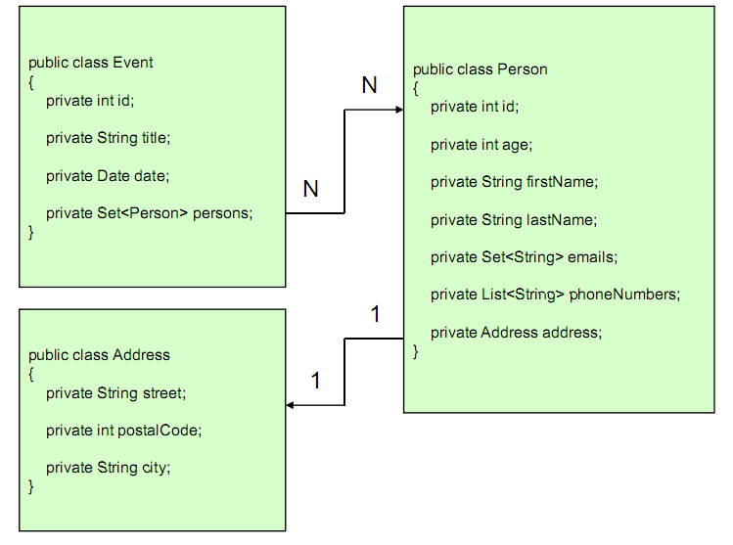
Contoh

Slide 6
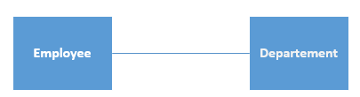

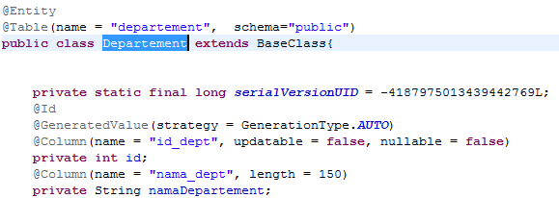
One To One Unidirectional

Slide 7
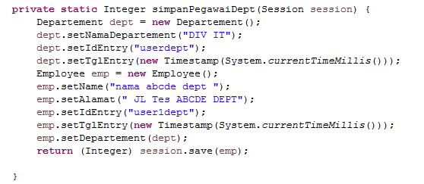
One To One Unidirectional 2

Slide 8
One To One 1 Exercise
Kelas Student
id (int)
Nama (String)
Alamat (Alamat)
Semua field yang ada di BaseClass
Kelas Kecamatan
Id (int)
Nama (String)
Kelas Alamat
Id(int)
Nama (String)
Kecamatan (Kecamatan)

Slide 9
One To One 1 Exercise
Buat Mapping nya
Buat proses insert, update, delete

Slide 10
One To One Bidirectional

Slide 11

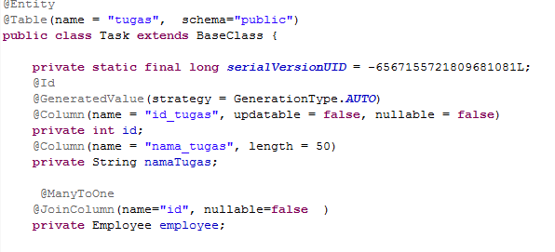
OneToMany

Slide 12
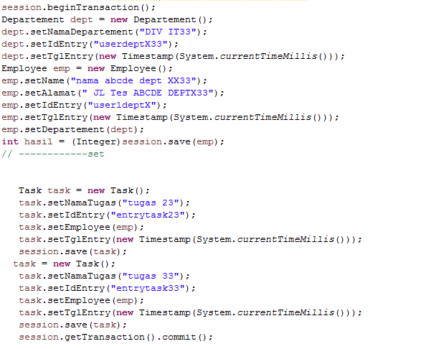
OneToMany

Slide 13
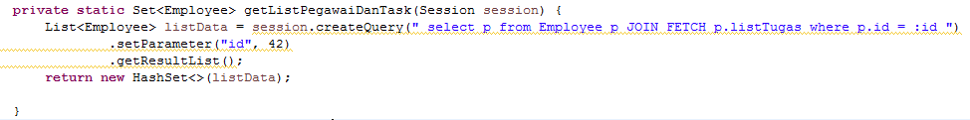
OneToMany

